Slide 1
WASH Data from 2024 ISNA

Slide 2
Background
Sampling Method: A stratified random sampling with probability proportional to the population size at camp level.
Sample Size: Refugees: 3,465 HHs (Ukhia 2730, Teknaf 735), 105 HHs from each Camps
Data Collection: A joint data collection process has conducted by ISCG, UNHCR/ACTED and IOM/NPM from August to September 2024, 90% confidence interval and 10% margin of error

Slide 3
Water
Average 23 liters of domestic water collected per person per day

Slide 4
Sanitation

Slide 5
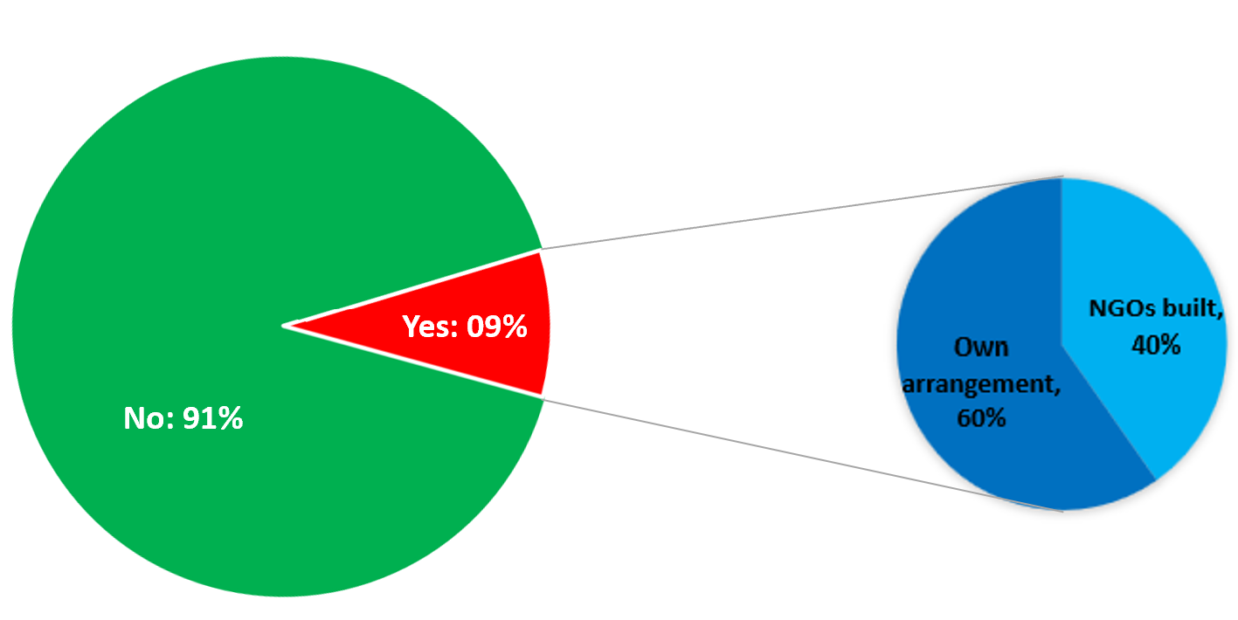
Privatization
% of households having their own private family latrine
% of households having built they private family latrine

Slide 6
Privatization

Slide 7
Privatization

Slide 8
Solid Waste Management

Slide 9
Solid Waste Management

Slide 10
Hygiene

Slide 11
Hygiene

Slide 12
Knowledge Sharing

Slide 13
Mainstreaming for WASH

Slide 14
Health Sector: Health Status and Concerns

Slide 15

Livelihoods and Skills Development Sector
Priority Needs and Gaps
73% of households have at least one income source
  79% of HH has single sources of Income
  55% of households earn less than 5,000 BDT/month (MSNA 2023 median income: 3,000 BDT)
35% of individuals contribute to household income
Men (25-60) are primary earners (23%), while women in this group contribute only 2%
Men (18-24) contribute 9%, women only 1%
How much is your total HH income average per month?
Range | %
1-3000 BDT | 23%
3001- 5000 BDT | 32%
5001_-7000 BDT | 22%
7001- 10000 BDT | 14%
above 10000 BDT | 9%

Slide 16
Livelihoods and Skills Development Sector
Priority Needs and Gaps
47% of households rely on casual labor (up from 38% in 2023 MSNA)
Only 8% of total engagement are women

Slide 17
AGE & DISABILITY
Demographic data
ISNA 2024 – Washington Group of Questionnaire (short set)
12% responded to have at least one disability (11% female, 13% male)
Breakdown per category
4.58% has difficulty seeing even after wearing glasses
2.85% has difficulty hearing even after wearing hearing aid
7.19% has difficulty walking and climbing steps
3.9% has difficulty remembering or concentrating
4.49% has difficulty with self-care
2.14% has difficulty understanding or being understood

Slide 18
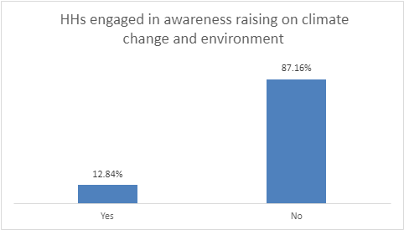
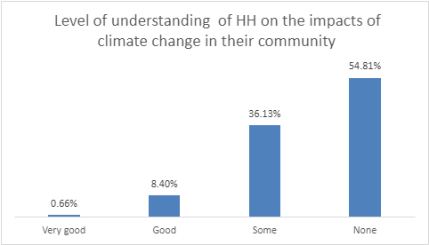
EEN: Strengthening community resilience

Slide 19
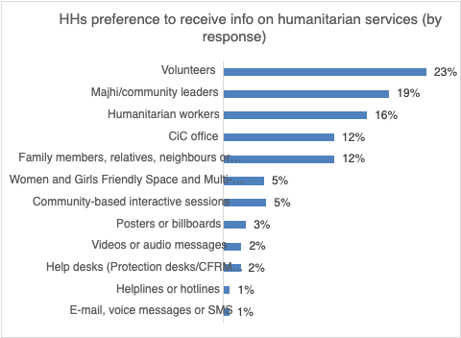
ACCOUNTABILITY TO AFFECTED POPULATIONS (AAP)
Information dissemination

Slide 20
The WASH Sector will provide feedback to Partners based on findings from the Inter Sector Needs Assessment (ISNA) 2024, conducted at the household level within the Camps.
This email communication will highlight areas identified from beneficiaries’ perceptions that require attention to enhance service delivery and improve hygiene standard across the Camps.

