Slide 1
Contingency Stocks Updates - 2025
Key points:
Partners reported stocks within their custody (along with the stocks received from AFAs)
IOM UNHCR and UNICEF have reported the stocks that they have in their own custody
BDRCS, DPHE : Non JRP Partner

Slide 2
Available Stocks for Partners
(Quantity available physically in the partner or stored centrally)
SL No | Stockpile of key WASH Items | Specification | UNIT | Total | Number of household covered in case of emergency | Number of beneficiaries covered in case of emergency | Remarks
1 | Hygiene kit/ 72-hour emergency kit | 1 kit/HH (avg. 5 indv.) | No. | 14,064 | 14,064 | 70,320 | 6% HHs will be covered
2 | MHM Kit | 1 kit/ women & girls in reproductive age | No. | 39,890 | - | 39,890 | 18% HHs will be covered 72-hour emergency kit (which include MHM items) Targeted: 308,000 Individuals
3 | Laundry Soap (125 - 150 gm) | 1 soap/ Person | Million | 0.3 | 59,417 | 297,086 | 27% HHs will be covered
4 | Bathing Soap (100 - 125 gm) | 1 soap/ Person | Million | 0.6 | 116,811 | 584,054 | 53% HHs will be covered
5 | Aqua tab (33 mg) | 200/HH for 15 days | Million | 12.3 | 61,664 | 308322 | 28% HHs will be covered for 15 days
6 | Jerry Can (10L) | 2/HH | No. | 27,699 | 13,850 | 27,699 | 6% HHs will be covered
7 | Water tank/bladder | 7.5L/person | m3 | 370 | 9,867 | 49,333 | 4% HHs will be covered (everyday)
8. Calcium hypochlorite, HTH, 65-70%: 3.8 tons. (existing 298 number of water networks can be distributed chlorinated water for one and half month)
9. Aluminium Sulftate - Al₂(SO₄)₃: 550kg ,
10.Tarpaulin: 1500 emergency latrines/bathing facilities will be covered
11. Desludging/Dewatering Pumps: 49
12. Chlorinating sprayers: 153, Tapstand: 49 unit
Source: WASH Partners, as of April 27, 2025

Slide 3
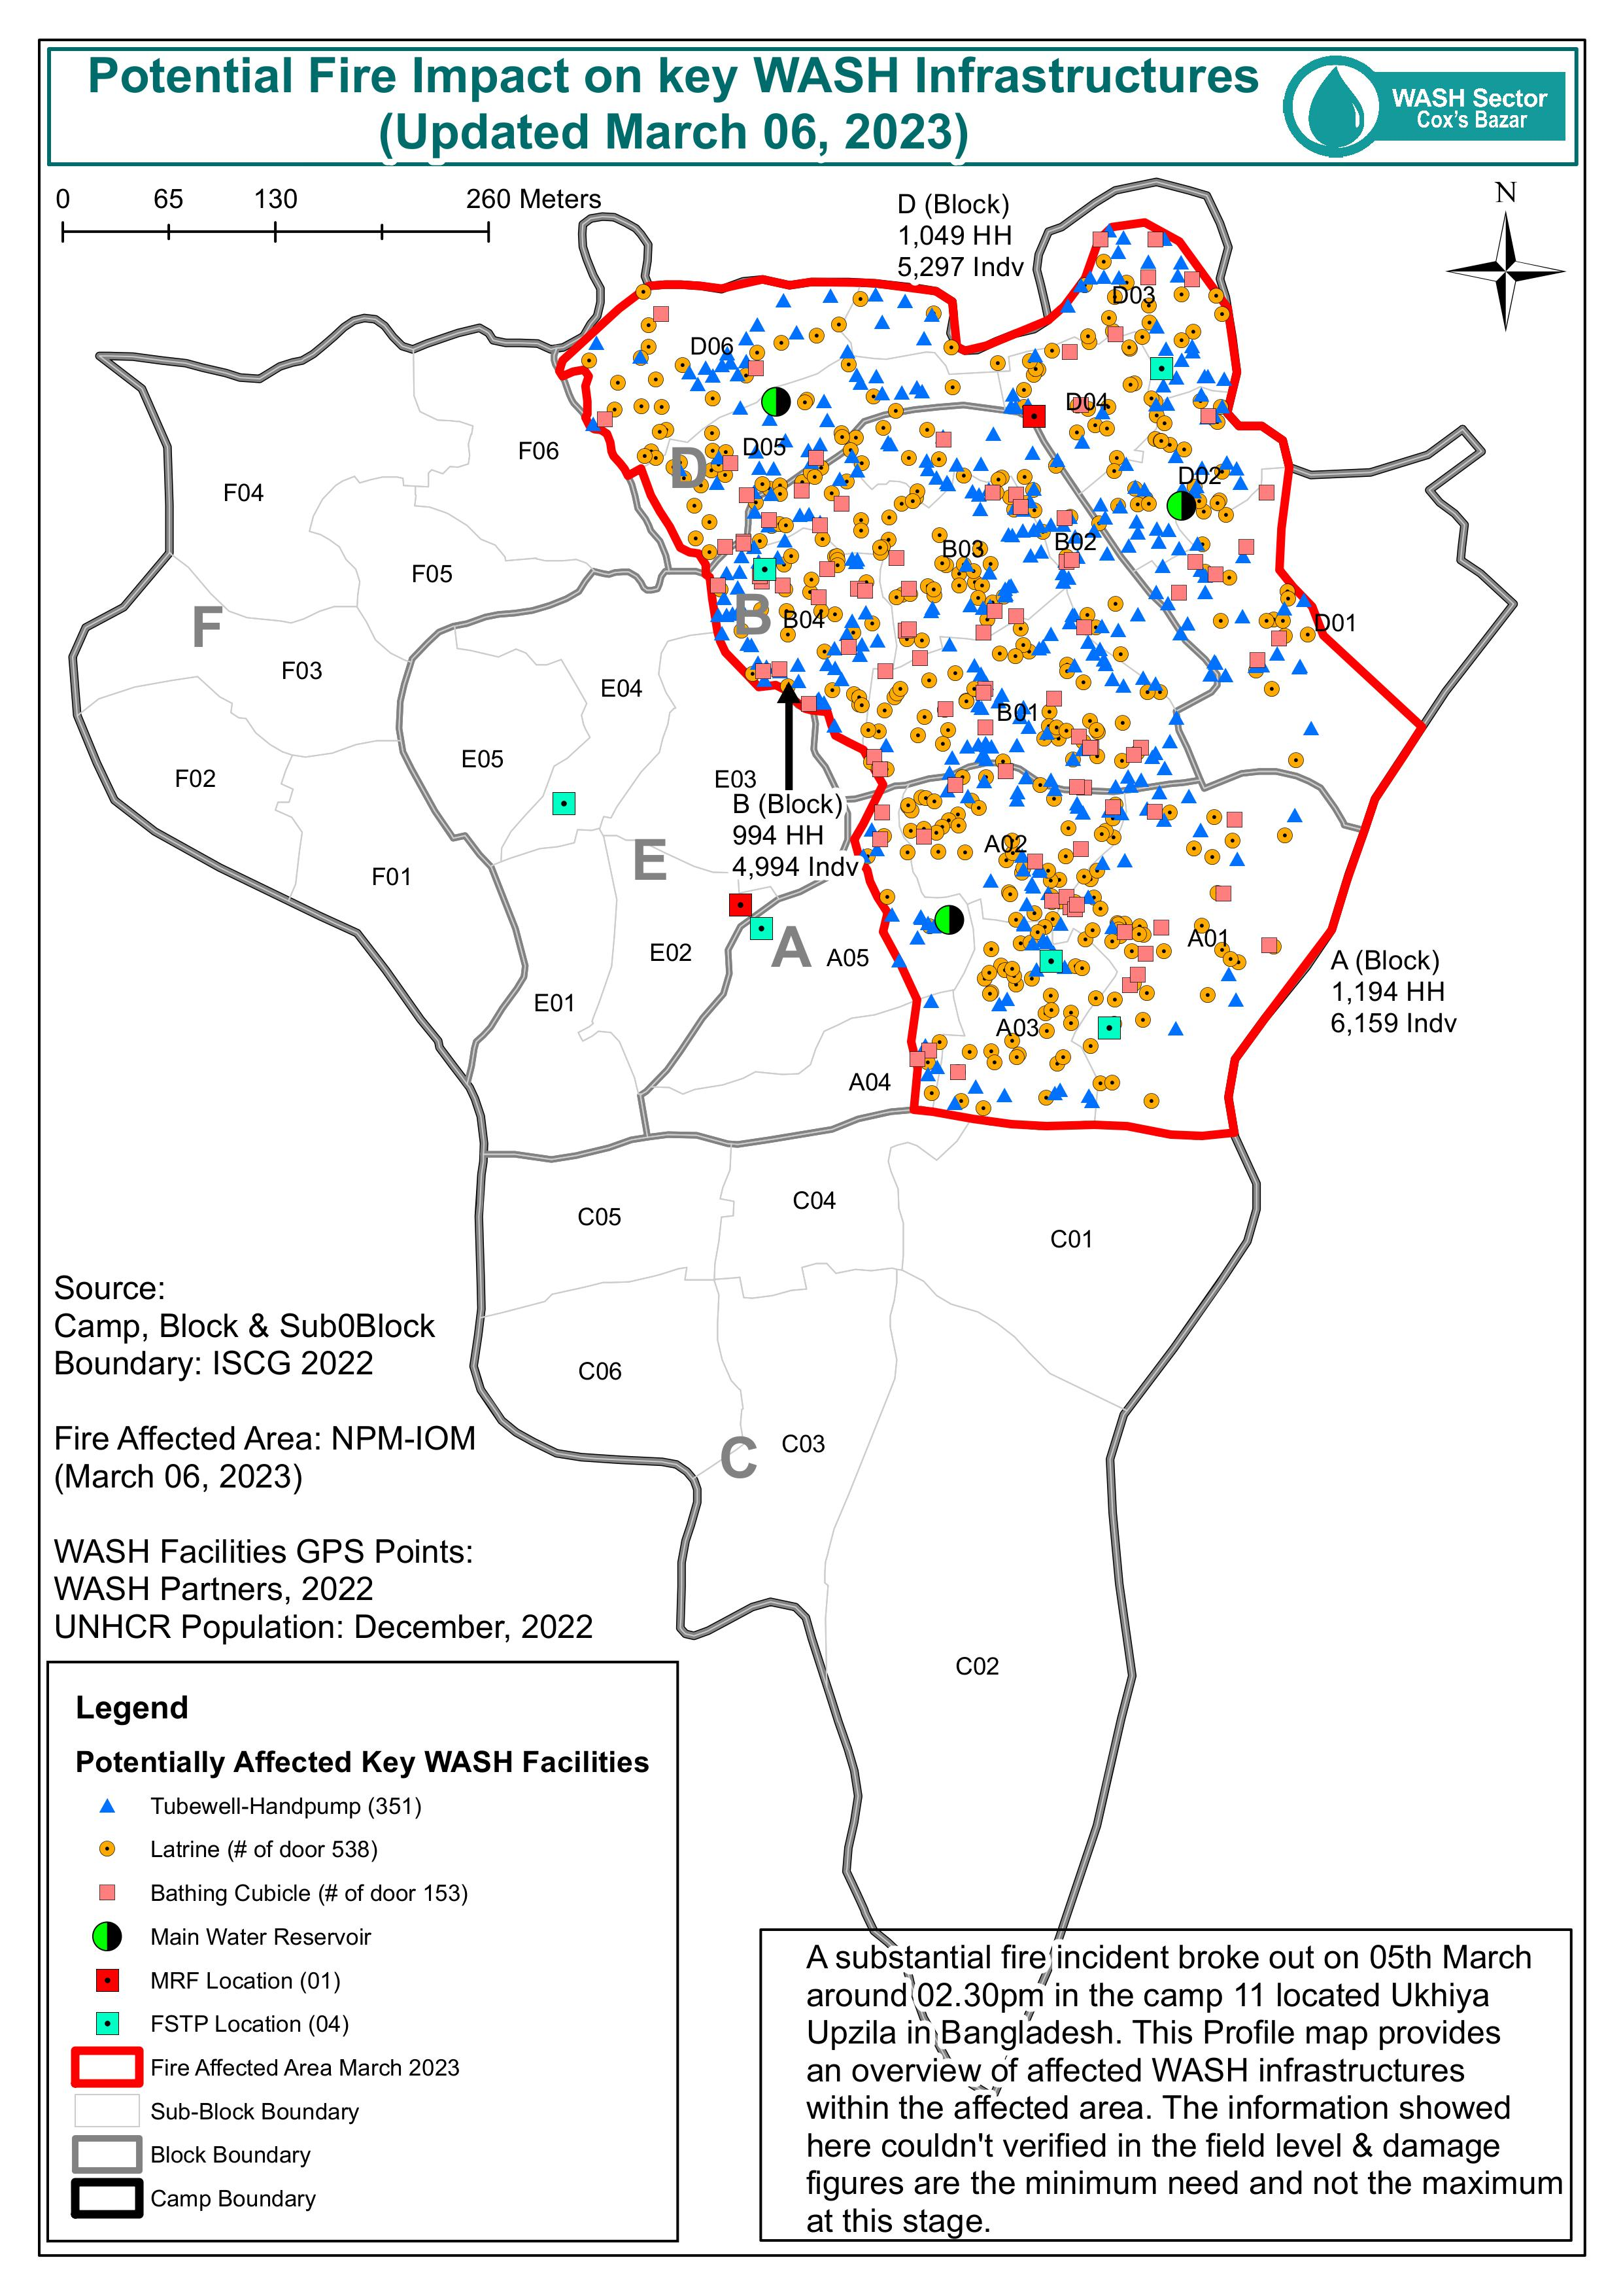
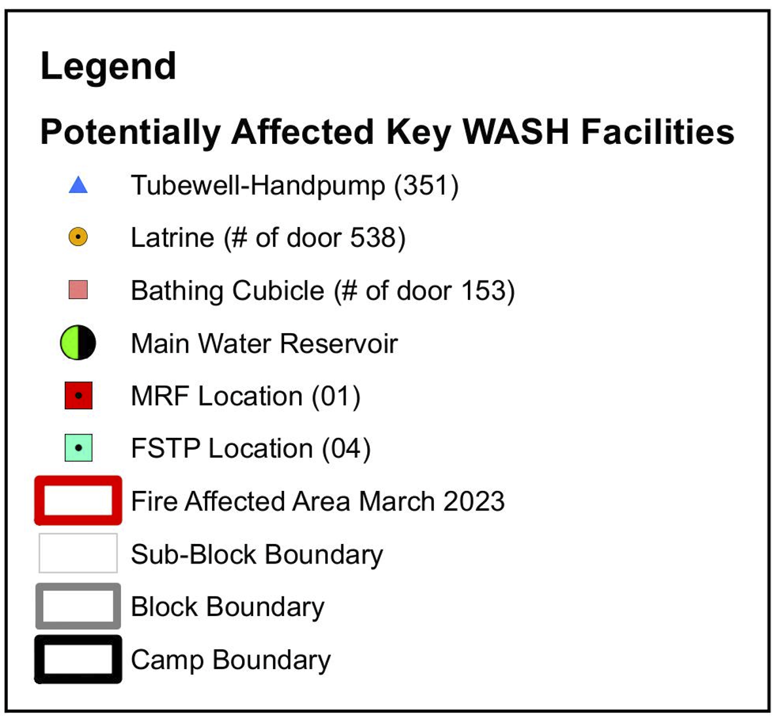
Emergency Response Assessment: Fire

Slide 4
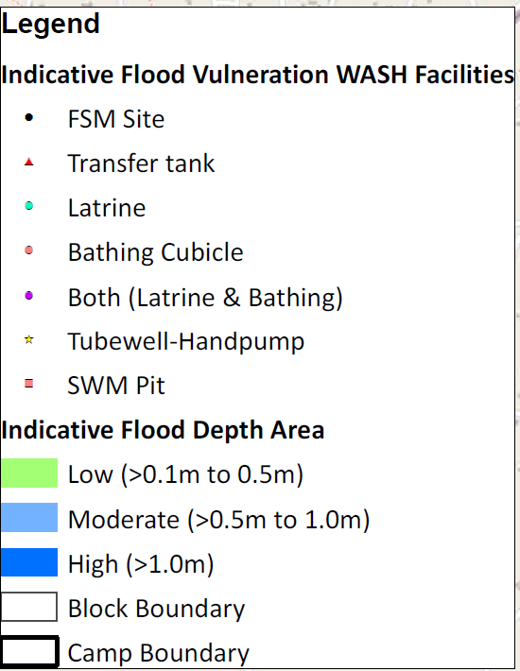
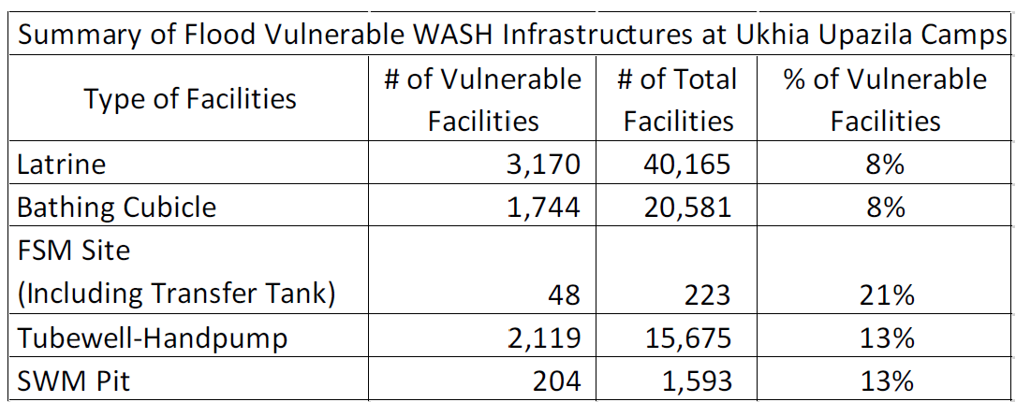
Emergency Preparedness: Flood
The aim of this map was to help planners & decision makers to identify priority area for WASH interventions at Uknia & Teknaf Upazila camps. This map represents the modelled water depth from a 10-year average return interval (ARI) pluvial flood event. Flood depths are derived from hydrodynamic flood modelling.
There are three types of flood at-risk areas has been classified based on depth,
Flood depth low (>=0.10m to 0.5m): impact is likely to be minor
Flood depth moderate (0.5m to 1.0m): need to be combined appropriate protection measures
Flood depth high (>1.0m): people & infrastructures are exposed, the zone should be avoided
(Source: Hydrodynamic Modelling v2.1– Deltares/WFP, 2019 for Ukhia Camps, WASH Infrastructures GPS Points: RECAH Coding (2019), WASH Partners & WASH Area Focal Agency (April 07, 2021).

