Slide 1
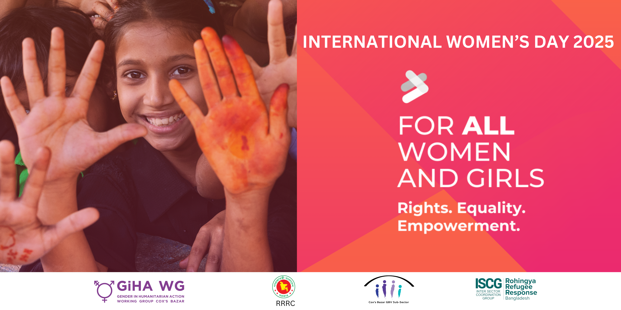

Slide 2




Camp-Level Consultation Findings

Slide 3
Introduction & Background
Focus Areas
As part of IWD 2025 — For ALL Women and Girls: Rights, Equality, Empowerment campaign, a series of camp-level consultations were held to move beyond symbolic celebrations and ensure real impact.
The discussion brought together women, girls, CiCs and other relevant actors to explore challenges, impact and possible solutions for gender equality in humanitarian response. Participants highlighted key challenges, shared lived experiences, and proposed actionable solutions to enhance women’s leadership, participation, and access to services.
Rights
Empowerment
Equality
Challenges
Impact
Solution

Slide 4
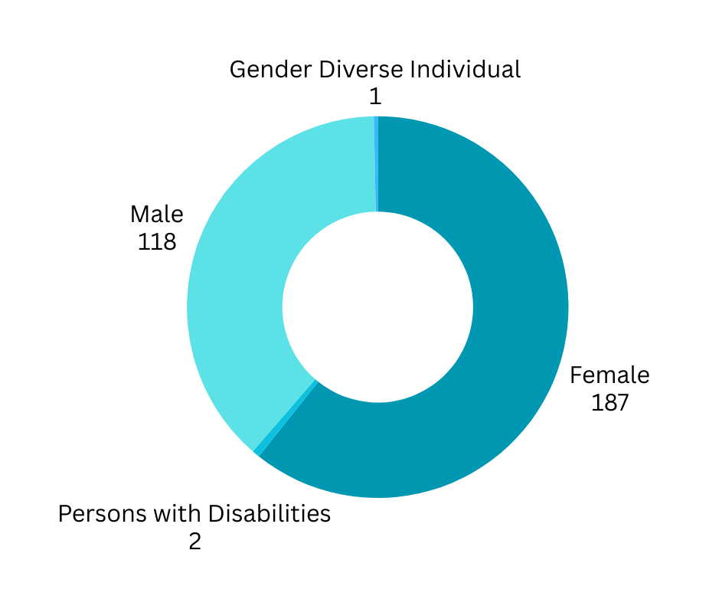
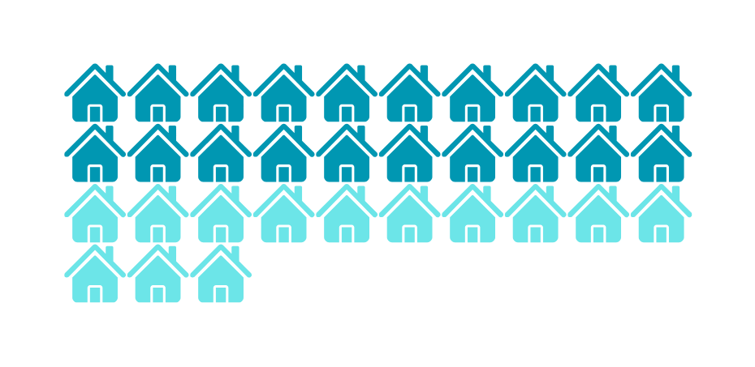
Objective and Camp Information
Objective
This consultation aimed to center the voices of Rohingya refugee women and girls along with the camp CiCs and other relevant stakeholders to understand the perspectives on gender equality
Camp 1E
Camp 1W
Camp 2E
Camp 2W
Camp 4
Camp 4 Ext
Camp 5
Camp 11
Camp 12
Camp 13
Camp 14
Camp 17
Camp 18
Camp 19
Camp 21
Camp 22
Camp 26
Camp 27
Kutupalong Rc
Nayapara Rc
Camps Covered
2 hours open discussion with guided questions.
20
308
Participants
Data Collection
Method

Slide 5
Challenges
01
02
03
  Early & Forced Marriage
  Gender-Based Violence (GBV)
  Social & Religious Barriers
Limits education and independence
Domestic violence, harassment, and lack of legal enforcement.
Traditional norms restrict mobility and decision-making
04
05
06
  Lack of Awareness
  Education & Employment
  Healthcare Access
Many women are unaware of their rights.
Cultural norms limit opportunities for education and employment
Women receive less medical support than men

Slide 6
Challenges
07
08
09
  Economic Disparities
  Lack of Gender-Sensitive Services
  Male-Dominated Society
Limited financial independence
Women, person with disabilities, and gender-diverse individuals struggle to access help.
Women’s opinions are undervalued
10
11
  Limited Political Representation
  Cultural & Power Imbalances
Social norms restrict female leadership
Few women in leadership roles

Slide 7






Impact
  Limited Education & Employment
  Mental & Physical Health Issues
  Social Isolation
  Weakened Community Progress
  Economic Dependence
School dropouts, no economic freedom.
Psychological stress, violence-related trauma
Restrictions prevent active participation in society
Gender inequality slows overall development.
Women remain financially reliant on men
01
02
03
04
05

Slide 8





Impact
  Low Literacy Rates
  Limited Participation
  Low Self-Confidence
  Reduced Economic Contribution
  Weaker Policies
Fewer women can complete education
Women have less influence in social, economic, and political spheres.
Women feel excluded from decision-making
Gender bias hinders financial independence and women’s economic contribution remains low.
Without women leaders, gender-blind policies persist
06
07
08
09
10

Slide 9





Law Enforcement & Accountability
Stricter enforcement of child marriage and GBV laws.
Increase Access to Education
Scholarships & literacy programs
Awareness & Education
NGOs & INGOs must promote gender equality more widely
Improved Healthcare Services
Gender-inclusive medical facilities
Solutions
Empowerment Programs
Inclusive Policies
Leadership & vocational training for women
Gender-sensitive laws & representation policies
Male & Community Engagement
Community Support Networks
Encouraging men to support gender equity
Encourage mentorship & female-led initiatives.

Slide 10
