Slide 1
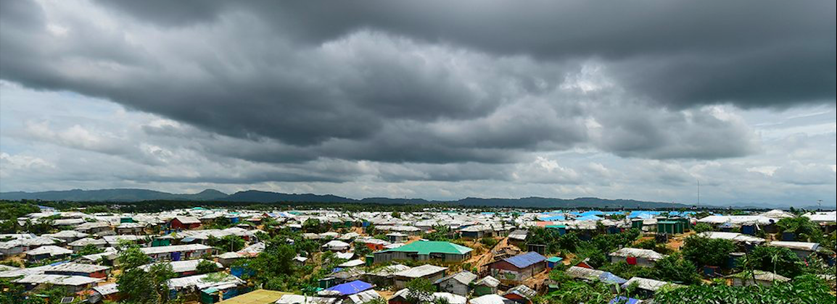


They Took Me To A Dark Place
The Experiences and Needs of Rohingya Hijra and Male Survivors of Sexual and Gender-Based Violence
Yuvraj Rathore
rathore@legalactionworldwide.org
Programme Coordinator
Legal Action Worldwide

Slide 2

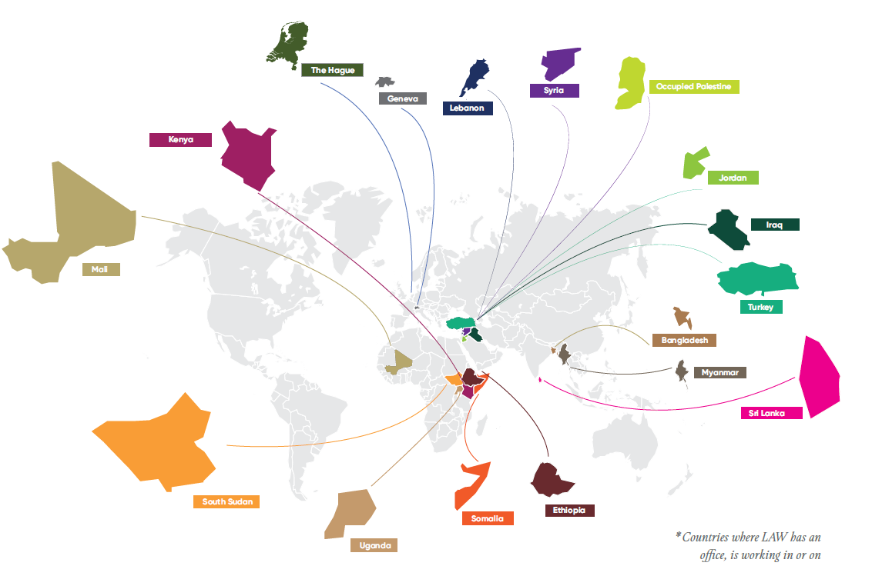

About LAW
Legal Aid and Empowerment
Strategic Litigation
Advocacy
Technical Assistance

Slide 3
In Bangladesh
Victims to Survivors to Advocates
Capacity Building
Empowerment and Engagement with Justice Mechanism
Rohingya-led information delivery to communities
Peer Support to Survivors
71 community members across 17 refugee camps trained to become grassroots champions
300+ Rohingya clients
21,000 + received legal information
Notes:
Since Jan 2021.

Slide 4
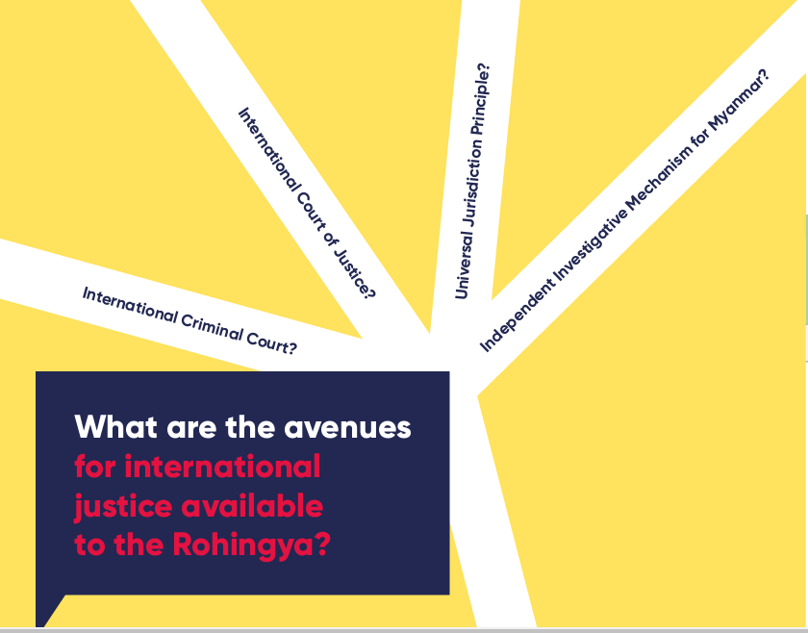
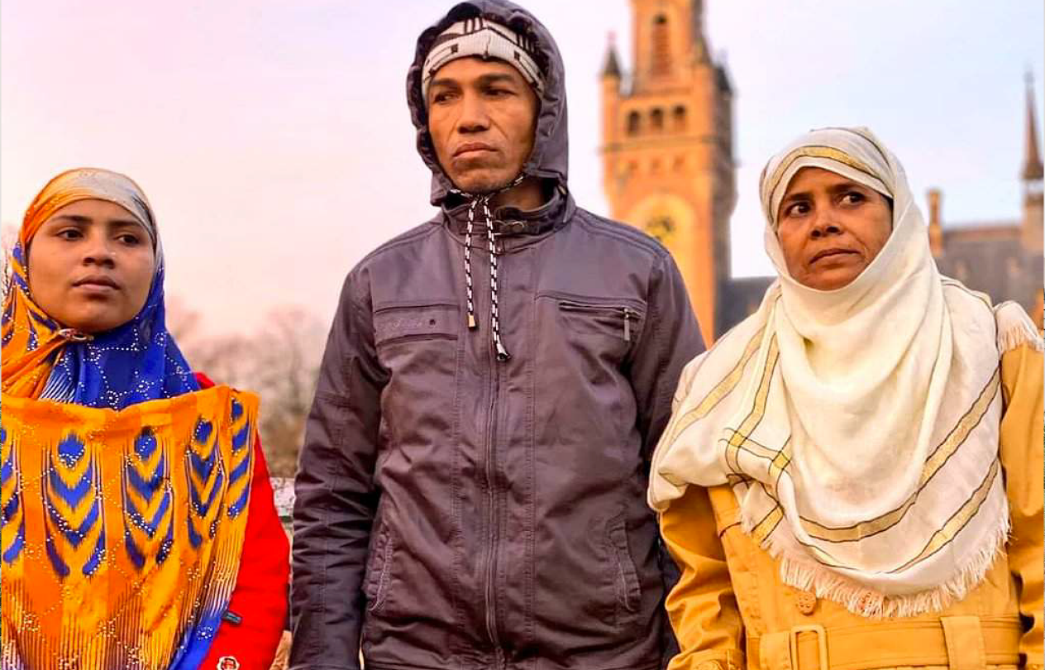
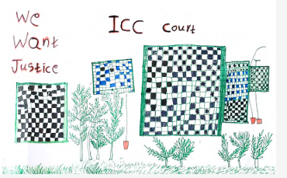

Slide 5
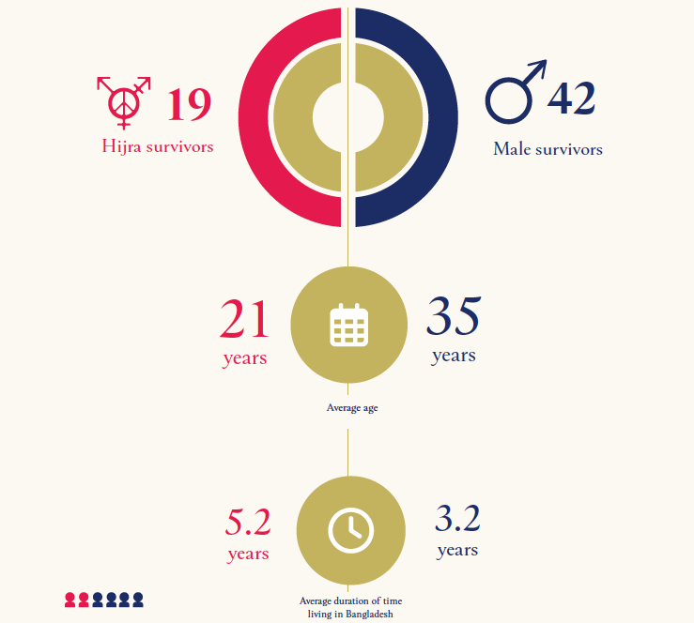



Methodology
72 organizations reviewed
61 survivor-centered surveys
42 Rohingya men
19 Hijra Rohingya
15 Interviews with service providers
They Took Me To A Dark Place
The Experiences and Needs of Rohingya Hijra and Male Survivors of Sexual and Gender-Based Violence

Slide 6
Six Key Findings
GBV against the hijra population is an urgent, ongoing protection concern.
Severe GBV against Rohingya men in Myanmar.
Male & hijra survivors of GBV ongoing physical & psychosocial needs - not adequately met.
IV. Male and hijra survivors have distinct concerns about seeking services.
V. A cycle of underreporting, lack of data means services for male/ hijra survivors are inadequate or unavailable.
VI. Male and hijra survivors of GBV do not perceive justice as possible.
They Took Me To A Dark Place
The Experiences and Needs of Rohingya Hijra and Male Survivors of Sexual and Gender-Based Violence

Slide 7
I. GBV against Rohingya Hijra
Location of GBV
Perpetrator of GBV
85% in Bangladesh
15% in Myanmar
They Took Me To A Dark Place
The Experiences and Needs of Rohingya Hijra and Male Survivors of Sexual and Gender-Based Violence

Slide 8
II. Severity of GBV against Men in Myanmar
97.4% of incidents of GBV perpetrated by ’military or police’
They Took Me To A Dark Place
The Experiences and Needs of Rohingya Hijra and Male Survivors of Sexual and Gender-Based Violence

Slide 9
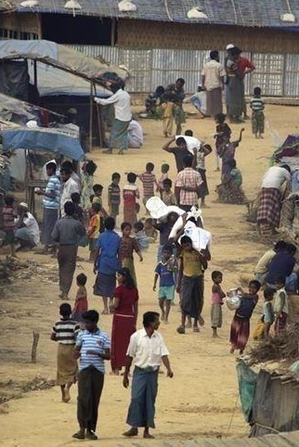
III. Survivor Needs Not Met
92.9% of male respondents report physical pain.
83.3% reported feeling hopeless afraid ‘most of the time’ or ‘all of the time.’
78.5% reported feeling afraid ‘most of the time’ or ‘all of the time.’
66.7% reported being unable to carry out essential activities ‘most of the time’ or ‘all of the time.’
Just 35.7% of male and 16.7% of hijra respondents received services.
They Took Me To A Dark Place
The Experiences and Needs of Rohingya Hijra and Male Survivors of Sexual and Gender-Based Violence
Notes:
.

Slide 10
IV. Distinct Survivor Concerns
Hijra
Men
Would not know where to go: 88.1%
Not enough accurate information: 88.1%
Concern about cost: 81%
Concern that services unavailable in Rohingya language: 69%
Not aware seeking services was an option: 83.3%
Opposition from family: 94.4%
Stigma: 83.3%
Will make them feel worse: 66.7%
They Took Me To A Dark Place
The Experiences and Needs of Rohingya Hijra and Male Survivors of Sexual and Gender-Based Violence

Slide 11
Focus on women and girls
Lack of services for male survivors
Male survivors not identified
Confusion around definition of SGBV
De facto exclusion of men
V. A Cycle of Exclusion
“We're dealing with a legacy of different viewpoints on GBV. . . Not all sexual violence in the camps is categorised as GBV. Our organisation had been serving men and boys and ended up locking horns with [global coordination body] who wanted to focus on women and girls. It causes a misunderstanding on the ground.” – Service Provider
They Took Me To A Dark Place
The Experiences and Needs of Rohingya Hijra and Male Survivors of Sexual and Gender-Based Violence

Slide 12
VI. Justice Impossible?
100% of male, 94.4% of hijra respondents: justice not possible for GBV.
Hijra Justice Priorities
Male Justice Priorities
Rights and remedies for survivors (50%),
Prevention of further crimes (33%).
Punishment of perpetrators (40.5%),
Prevention of further crimes (21.4%).
They Took Me To A Dark Place
The Experiences and Needs of Rohingya Hijra and Male Survivors of Sexual and Gender-Based Violence

Slide 13
Six Recommendations
1. Establish and adequately fund integrated services for male and hijra survivors of SGBV, including emergency protection services.
2. Partner with Rohingya to create effective services for male and hijra survivors, utilizing community-led and peer-to-peer approaches for better outreach.
3. Advocate for review and reform of restrictions on movement within the Rohingya camps which limit access to services for survivors of SGBV .
4. Review Rohingya access to domestic justice mechanisms to identify areas for reform.
5. Review the national legal framework to ensure SGBV against men, boys and hijra is effectively criminalized.
6. Increase delivery of legal information on international justice mechanisms to all Rohingya, including the hijra community.
They Took Me To A Dark Place
The Experiences and Needs of Rohingya Hijra and Male Survivors of Sexual and Gender-Based Violence

Slide 14
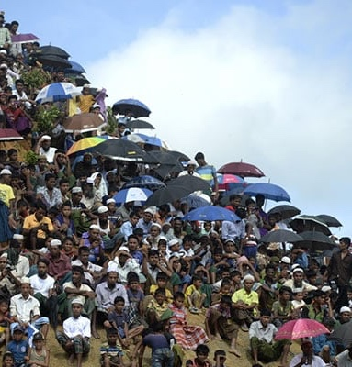

Establish and adequately fund integrated services for male and hijra survivors of SGBV, including emergency protection services.
Inclusion in planning and project design;
Training and support for those delivering services;
Services provided by male and hijra service providers;
Emergency protection and safe spaces.
Integrated
Dedicated
They Took Me To A Dark Place
The Experiences and Needs of Rohingya Hijra and Male Survivors of Sexual and Gender-Based Violence

Slide 15
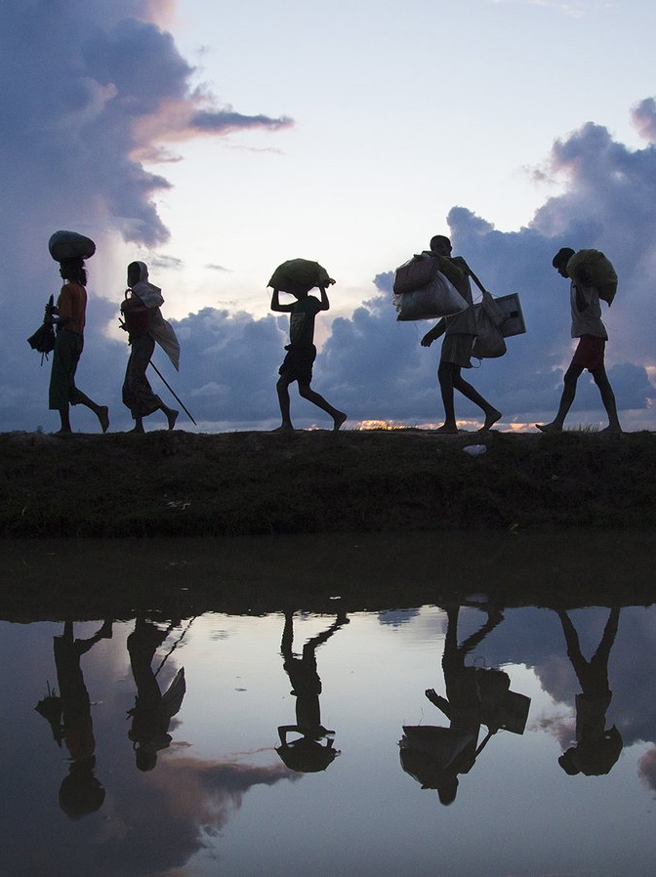
2. Partner with Rohingya to create effective services for Rohingya survivors, utilizing community-led and peer-to-peer approaches for better outreach to male and hijra survivors.
Engage
Empower
They Took Me To A Dark Place
The Experiences and Needs of Rohingya Hijra and Male Survivors of Sexual and Gender-Based Violence

Slide 16
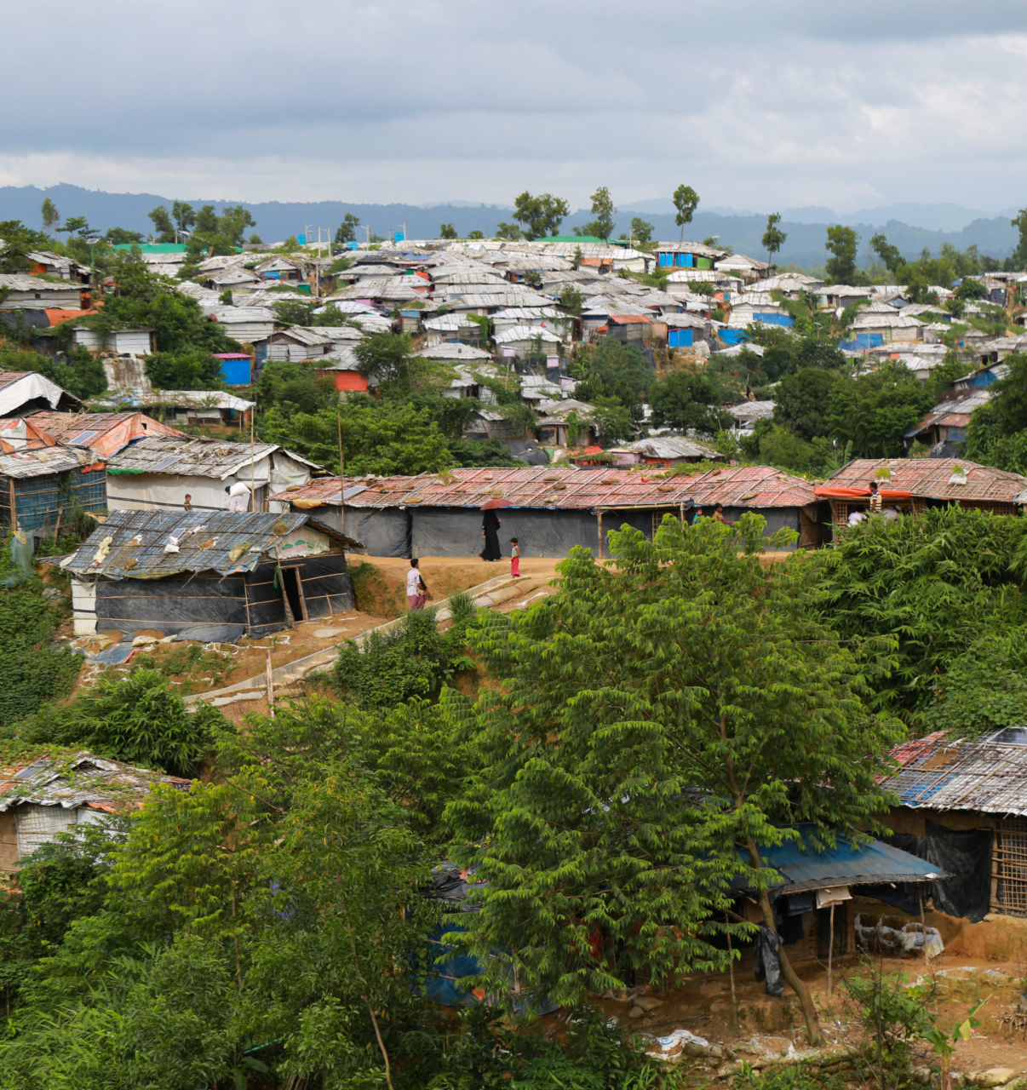
3. Advocate for review and reform of restrictions on movement which limit access to services for survivors of SGBV.
Applies to many protection services;
Recognition of SGBV services as essential part of emergency response;
Inclusion of male and hijra survivors;
They Took Me To A Dark Place
The Experiences and Needs of Rohingya Hijra and Male Survivors of Sexual and Gender-Based Violence

Slide 17
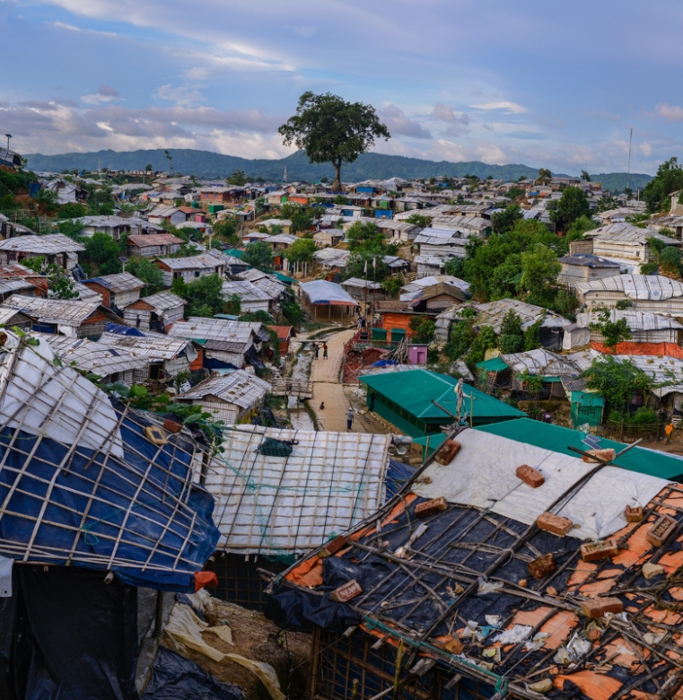
4. Review Rohingya access to domestic justice mechanisms to identify areas for reform.
CiCs and the Mobile Courts Act;
Assumption that Rohingya issues are resolved within the camps;
Informal mechanisms within the camps;
They Took Me To A Dark Place
The Experiences and Needs of Rohingya Hijra and Male Survivors of Sexual and Gender-Based Violence

Slide 18


5. Review the national legal framework to ensure SGBV against men, boys and hijra is effectively criminalized.
Section 375 Penal Code
Women and Children Repression Prevention Act 2000
Section 377 Penal Code
They Took Me To A Dark Place
The Experiences and Needs of Rohingya Hijra and Male Survivors of Sexual and Gender-Based Violence

Slide 19
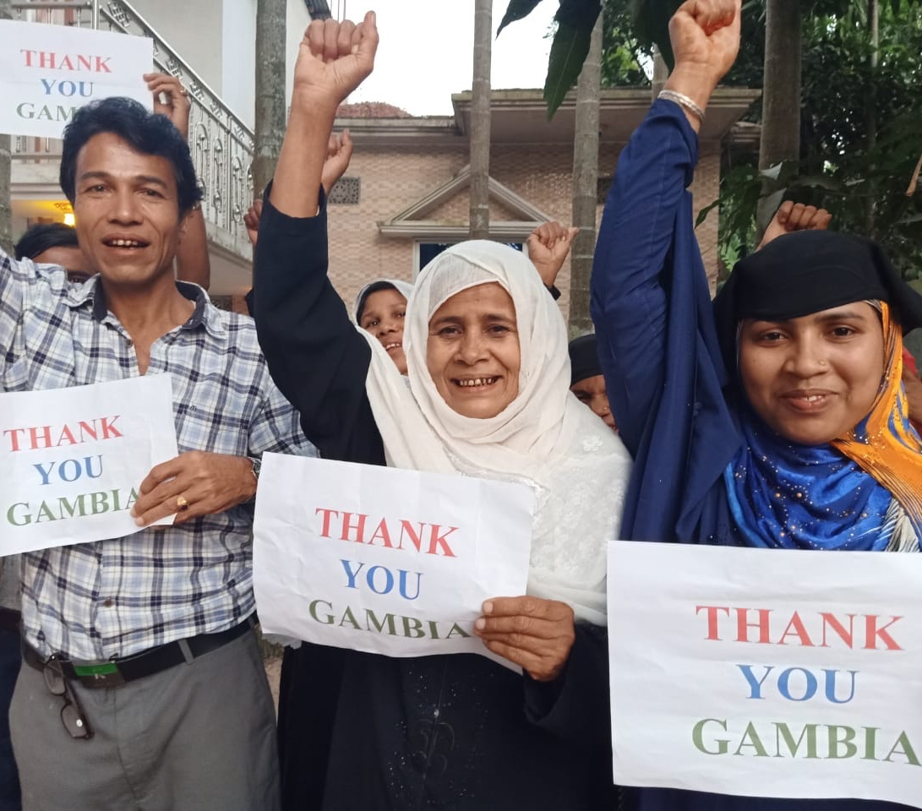
6. Increase delivery of legal information on international justice mechanisms to all Rohingya, including the hijra community.
In Rohingya language, delivered by Rohingya;
Inclusion of the Hijra community;
Address myths and misconceptions;
Increase legal representation in respect of international justice processes.
They Took Me To A Dark Place
The Experiences and Needs of Rohingya Hijra and Male Survivors of Sexual and Gender-Based Violence

Slide 20
Thank You
Rathore@legalactionworldwide.org
They Took Me To A Dark Place
The Experiences and Needs of Rohingya Hijra and Male Survivors of Sexual and Gender-Based Violence

