Slide 1
HUMANITARIAN ACCESS

Slide 2
Access: OCHA’s role on Access
At the global level, OCHA advocates for the safe, timely and unimpeded access including through reporting instances of grave concern to the Security Council, and supporting efforts to increase access on the ground.
At the country level, OCHA facilitates and coordinates efforts to establish and maintain access. OCHA develops tools and provides guidance and support to the HC and the HCT. OCHA also facilitates efforts to monitor access.
OCHA’s roles at the global and field level are interlinked and complementary.

Slide 3
Access: Tools and Services
What is OCHA Minimum Package of Services on Access?
This ‘Package” provides OCHA with a more predictable and systematic way to approach access issues across the organisation. It spells out the services we should provide to HCs and HCTs to enhance access and includes a toolbox of templates, guidance notes, tip sheets, etc.
How is it relevant to your deployment?
The Minimum Package can be used at any stage of an OCHA office life cycle. It can be used as a self-auditing tool, a road map or guidance.

Slide 4
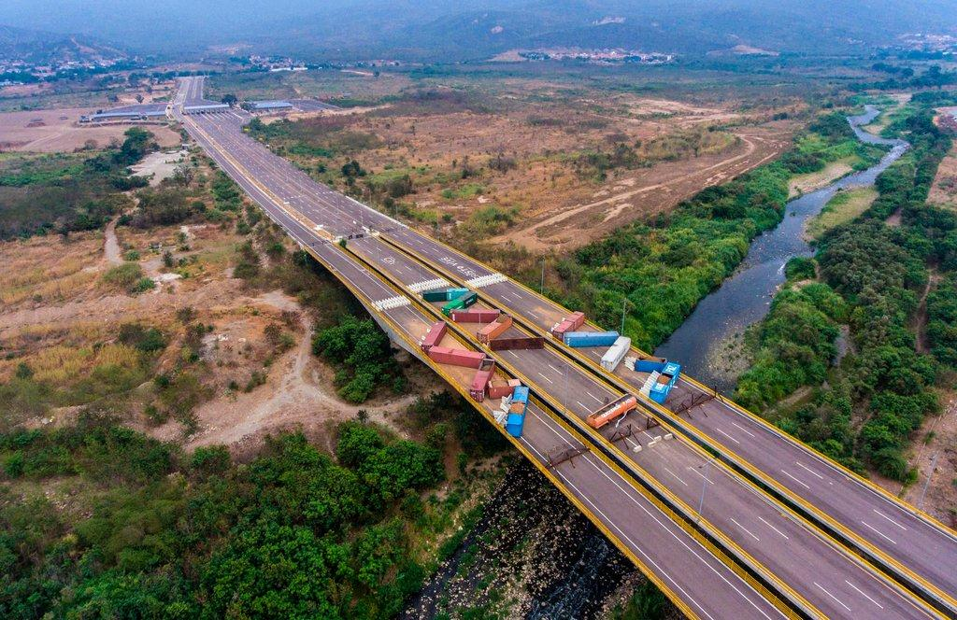
Access: Tools and Services
At a minimum, OCHA should ensure that:
1. Access constraints are known and monitored
Tools: Incidents database (e.g Kobo), bureaucratic impediments monitoring, access severity mapping, stakeholders analysis, etc.
2. Humanitarian actors have a coordinated approach on access
Tools: Ground rules/ red lines/ code of conduct, access working group, engagement strategy, etc.

Slide 5
Access: Tools and Services
3. Options for enhanced access are identified
Tools: Access strategy, Access action Plan, collaboration with CMCoord.
4. The humanitarian community advocates for a safe, timely and unimpeded access
Tools: Statements, public and private advocacy, key messages, etc.

Slide 6
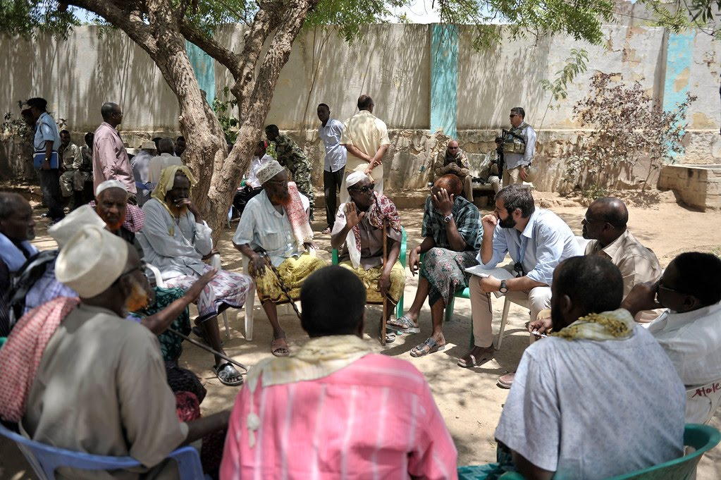
Access: Humanitarian Negotiations
OCHA engages in negotiations with parties to the conflict on behalf of the humanitarian community when requested or when its mandate is perceived as a comparative advantage to lead the negotiations.

Slide 7
Access: Humanitarian Negotiations
Examples of issues OCHA can engage on:
Act as a third-party mediator/facilitator when requested by the humanitarian community (to facilitate movements, release detained staff, etc.).
Negotiate humanitarian corridors, days of tranquility, cross-line movements or inter-agency convoys to highly insecure areas.
Establish and maintain a deconfliction mechanism, as required.
Negotiate policy, legal, administrative and other systemic issues hampering humanitarian assistance (visa, customs, excessive administrative procedures or fees, etc.).
Negotiate and/ or defuse tensions around programme implementation, prioritization of needs/ vulnerable groups, acceptance of humanitarian actors and services, etc.

Slide 8
Access: Humanitarian Negotiations
Some considerations:
Humanitarian partners may choose to conduct negotiations in a private and confidential manner. In such situations, OCHA should stand ready to support when needed, and ensure that the outcomes of such negotiations do not compromise the overall operating environment.
When engaging with parties to the conflict, it is essential to identify which organization has the most comparative advantage to conduct the negotiations. It may vary over time and from one location to another. Factors such as history, context, knowledge, personality, mandate, function and culture need to be considered when identifying the leading organization and the negotiator/mediator.
The most senior person may not necessarily be the most appropriate negotiator.

Slide 9
Access: Useful resources
And… the Policy Advice and Planning Section (PAPS)!

Slide 10
Conclusion
Key take-aways:
Protection and Access are a shared responsibility. All OCHA staff have a role to play in supporting the access agenda.
OCHA needs to be more systematic and predictable in its way it approaches access and protection. A strong analysis is the backbone of any access or protection action plan.
Best practices, guidance and tools exist. They are captured in the Minimum Package of Services on Access. A Protection Essentials is under development.
PAPS is available to support you in the implementation of the access and protection portfolio.

